Slide 1
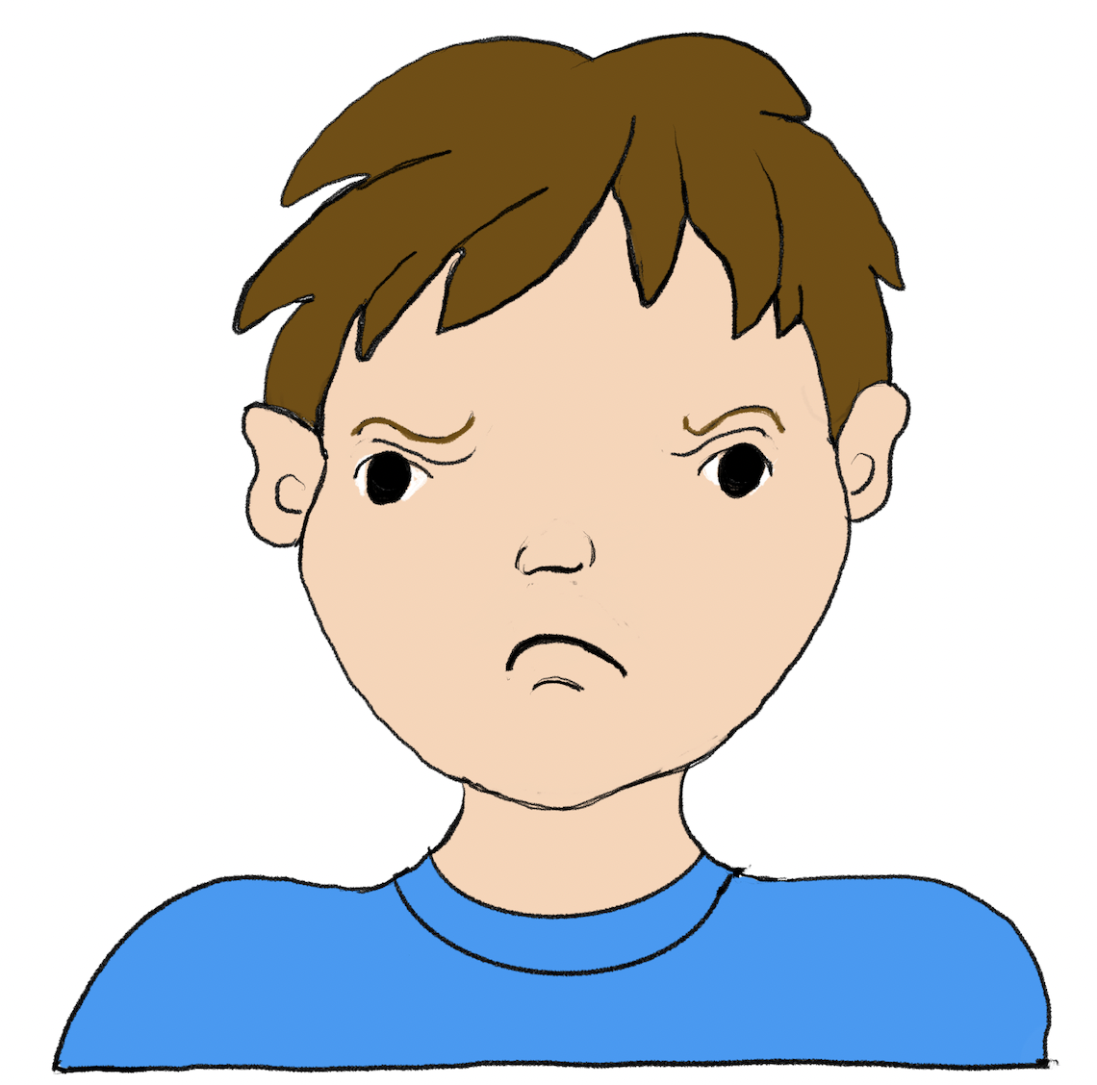
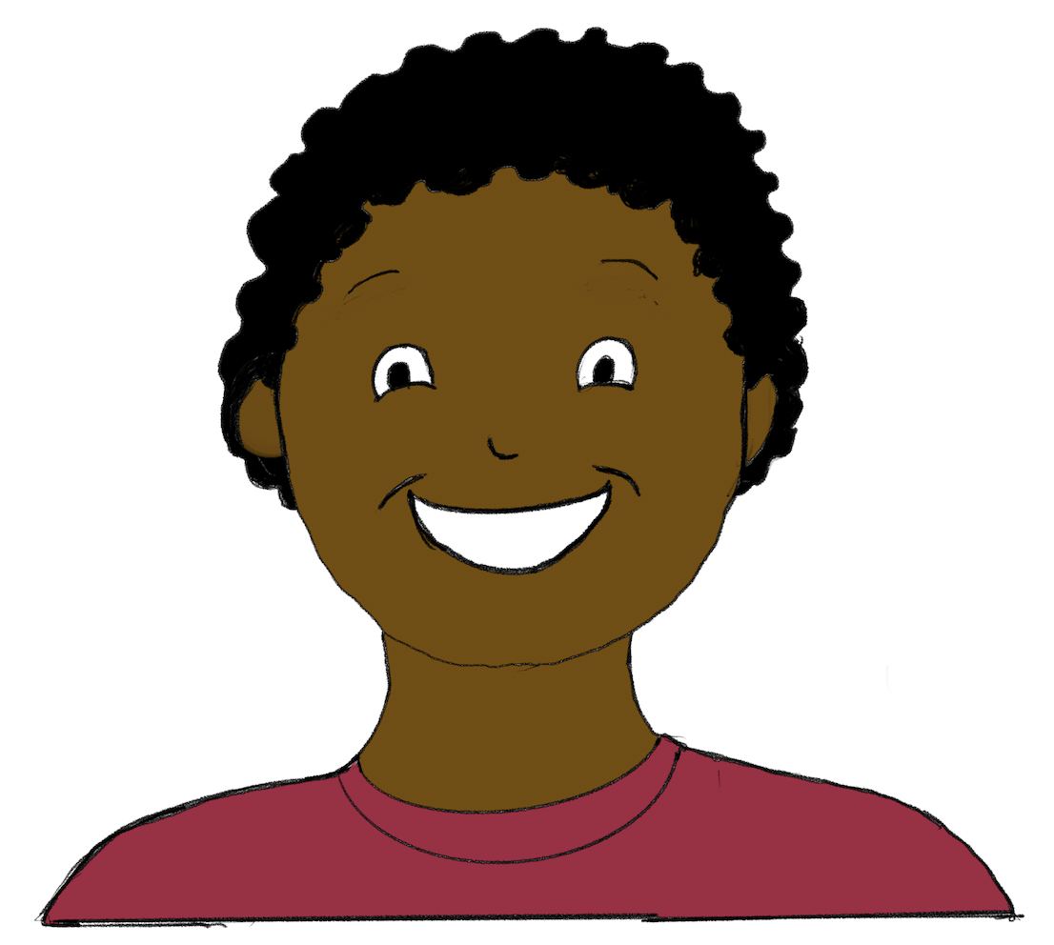
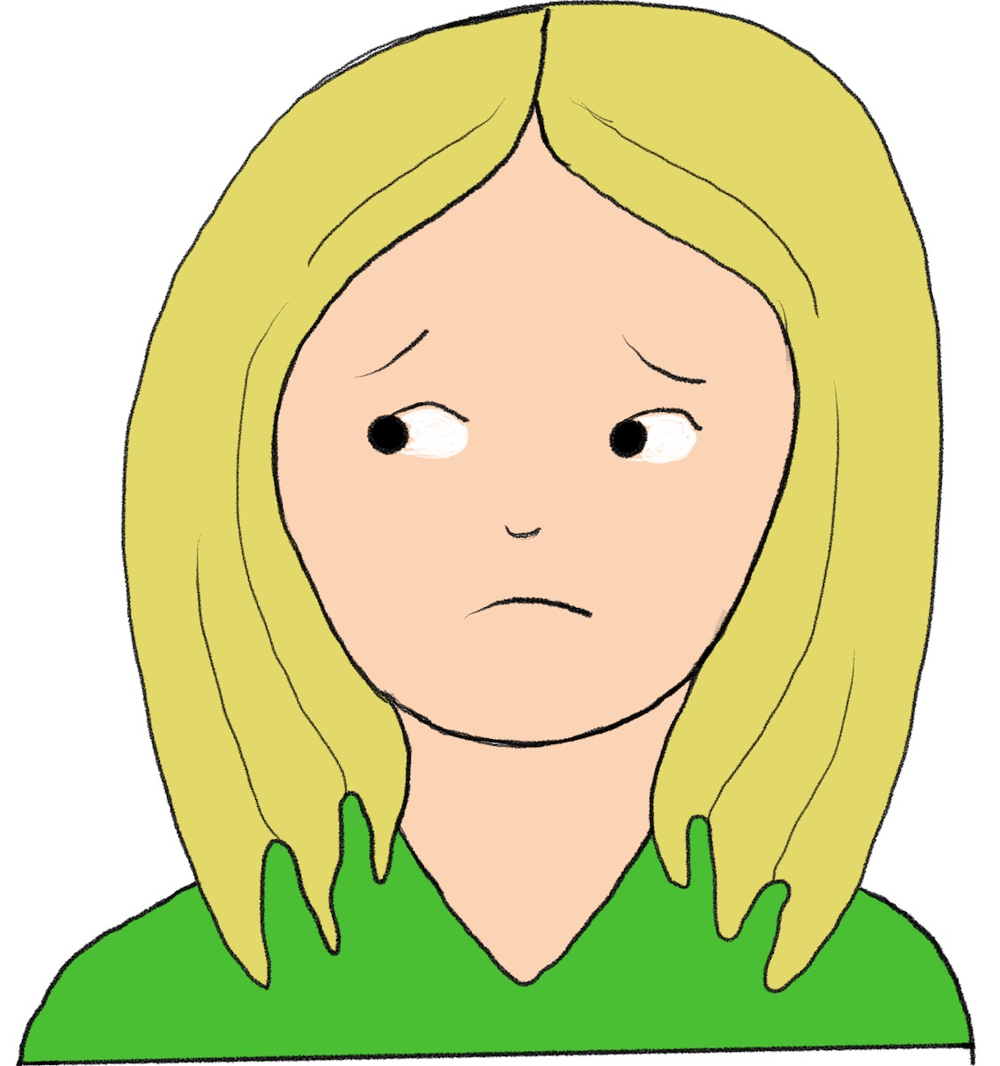
My Feelings & Your Feelings
Notes:
Copyright 2006 by Safe Life Coalition
All rights reserved.
Slide Discussion
Today we are going to learn about feelings. We will talk about feelings that we have ourselves, and we will talk about feelings that other people have. We will also talk about expressing our feelings.
Sample Goals
(All goals for lessons 1-12 can be found in Getting Started folder.)
Feelings In Self and Others
By (month/date/year), given verbal descriptions (or pictures) of the student in 3 different situations, each of which evokes a different feeling (happy, sad, or angry), the student will communicate how he/she would feel in each situation (e.g., happy, sad, mad) and why he/she would feel that way; with 100% accuracy, in 4 out of 4 trials, on 4 out of 4 trial days, as measured by teacher observation and collected data.
By (month/date/year), given verbal descriptions (or pictures) of the student in 3 different situations, each of which evokes a different feeling (happy, sad, or angry), the student will communicate an appropriate natural response he/she might have in each of the situations (e.g. smile and thank you, cry and tell adult, deep breaths and tell adult); with 100% accuracy, in 4 out of 4 trials, on 4 out of 4 trial days, as measured by teacher/staff observations and collected data.
By (month/date/year), given verbal descriptions (or pictures) of a person (other than the student) in different situations, each of which evokes a different feeling (happy, sad, or angry), the student will communicate how the person would feel in each situation (e.g. happy, sad, mad) and why he/she would feel that way; with 100% accuracy, in 4 out of 4 trials, on 4 out of 4 trial days, as measured by teacher/staff observations and collected data.
Sample Comprehensive Goal
By (month/year), the student (will continue) to make safe choices in natural and facilitated situations and will report problems as needed; with 100% accuracy, in 4 out of 4 different situations, on 4 out of 4 trial days, as measured by teacher/staff observations and collected data. (Natural and facilitated situation testing environments can be in-person and/or virtual.)

Slide 2
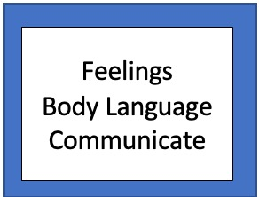
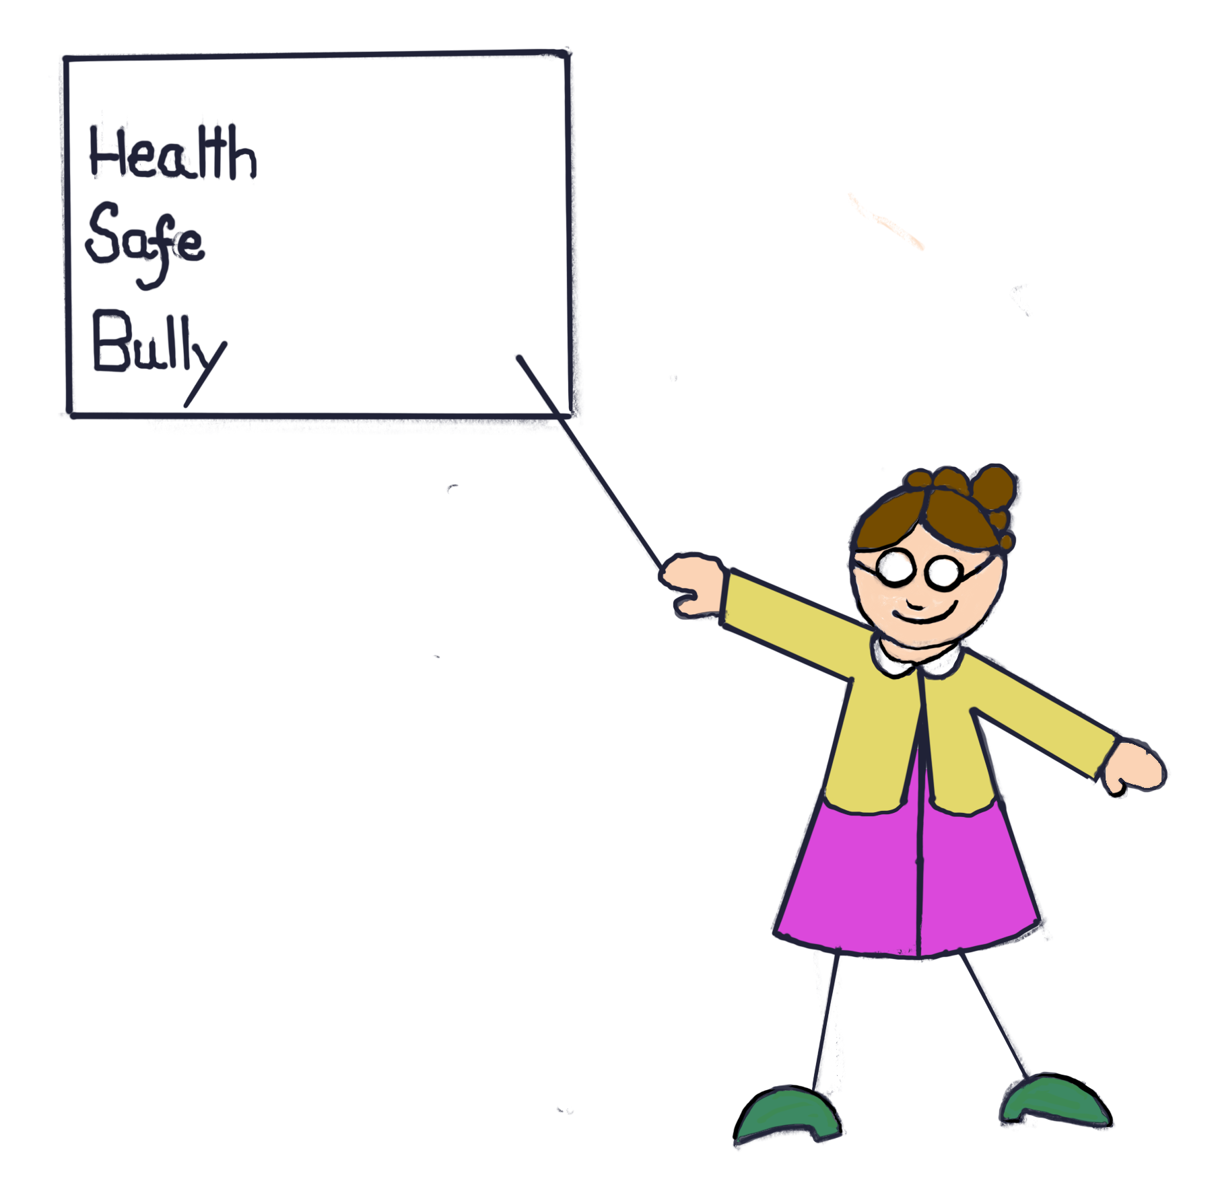
Vocabulary
Notes:
Slide Discussion
Here are some words we need to know for this lesson.
Feelings.
Body Language.
Communicate.

Slide 3
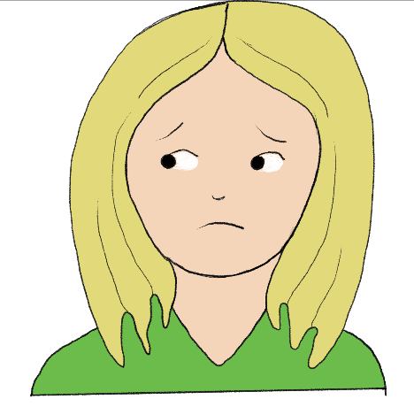
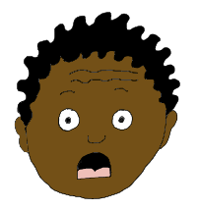
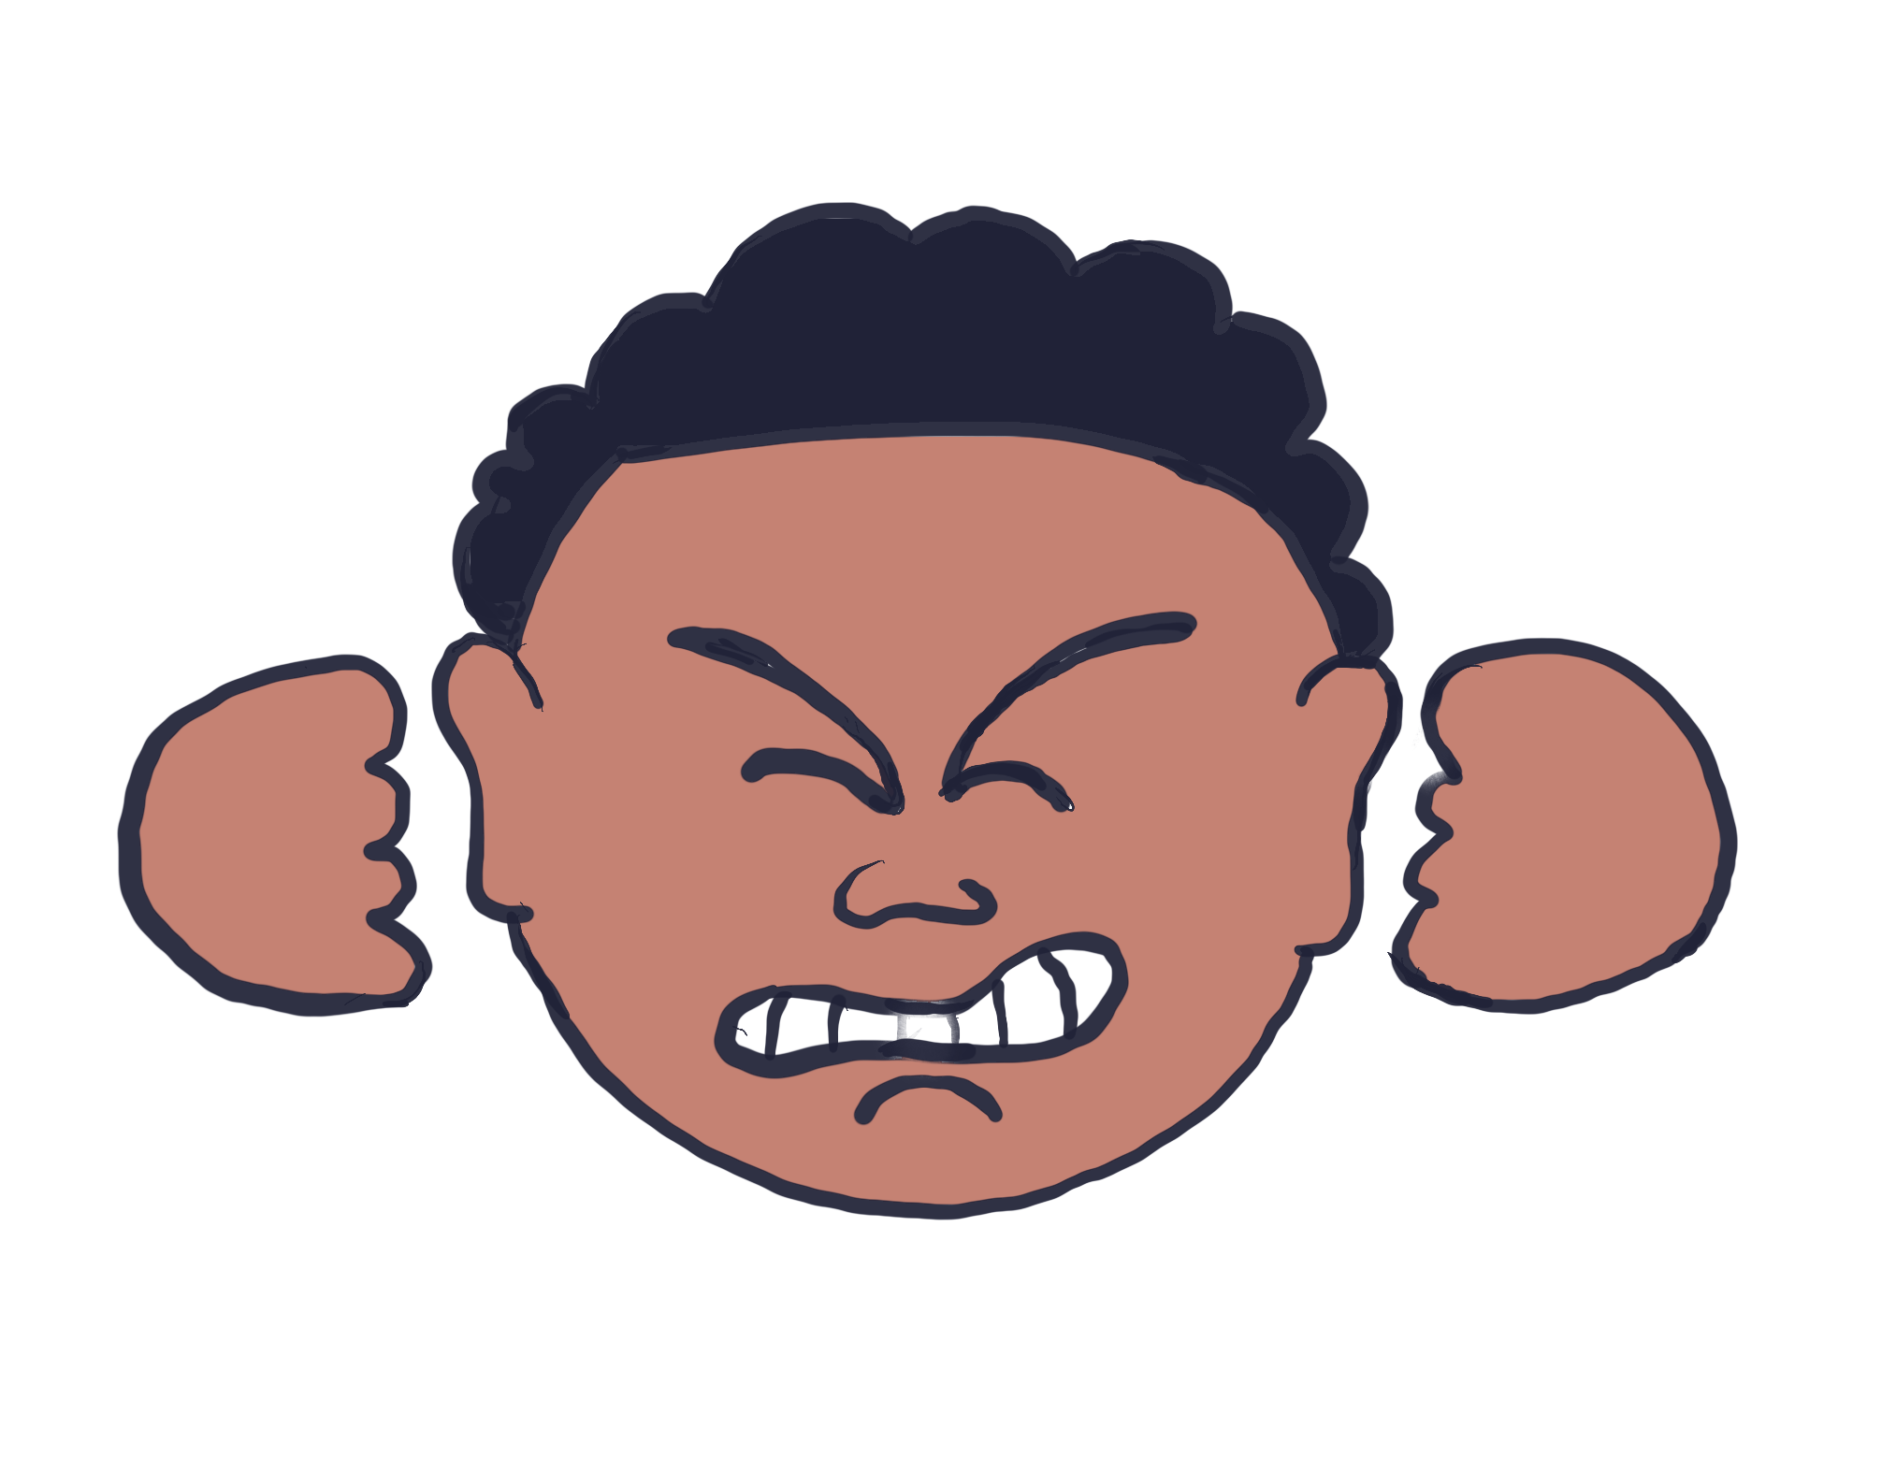
Name The Feeling
41
Notes:
Slide Discussion
Let’s practice naming feelings that we think a person might have after certain things happen.
How would you feel if…
You were winning a game?
Someone grabbed something from you without asking?
Your pet died?
You were going to go to Disneyland, but then plans changed, and you didn’t get to go after all?
It was cold and rainy outside with thunder and lightening?
You had to go to the doctor to get a shot?
It was your turn to answer questions in front of the whole class?
You accidentally broke your teacher’s coffee cup?
Someone called you a name?
Someone bossed you around?
You broke your friend’s tablet?
A big, mean dog was barking at you?
You got invited to a party?
Someone in your family was sad?
You mom and dad were fighting?

Slide 4
Frustrated
Notes:
Slide Discussion
This person is feeling frustrated. You can tell he is frustrated because he is clenching his fists tightly, and he is gritting his teeth. He looks like he can’t do or get something that he needs.
This is how my face looks when I am frustrated.
(Clench your jaw, or model in another way to show a frustrated expression; it’s ok to exaggerate the expression.)
Show me how your face looks when you are frustrated.
(Call on individual students to demonstrate. Prompt and reinforce as needed.)
This is how my body looks when I am frustrated.
(Clench your fists, tighten your body or model in another way how a frustrated person looks; it’s ok to exaggerate the expression.)
Show me how your body looks when you are frustrated.
(Call on individual students to demonstrate. Prompt and reinforce as needed.)
This is how my voice sounds when I am frustrated.
(Model a frustrated voice.)
“Oh, I’m frustrated!”
How does your voice sound when you are frustrated? Use your frustrated voice and say something.
(Call on individual students to demonstrate. Prompt and reinforce as needed.)

Slide 5
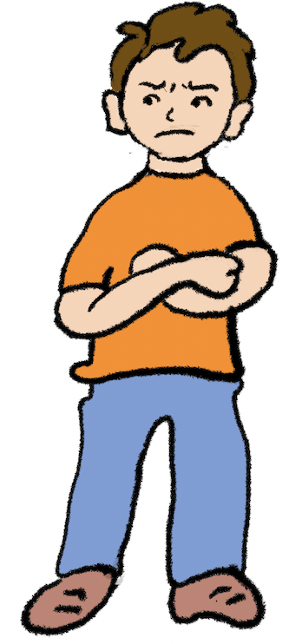
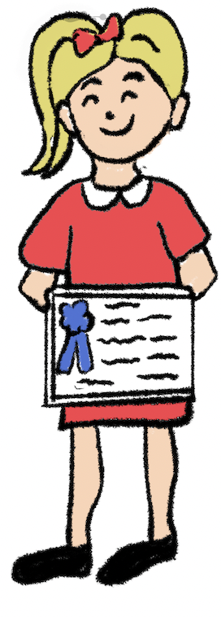
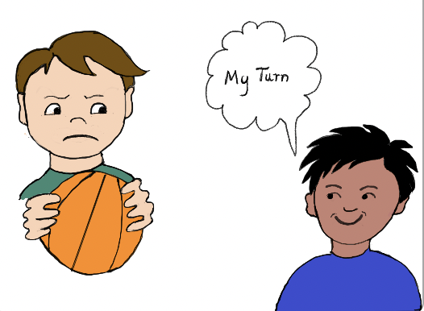
What Can Make A Person Feel Frustrated?
Notes:
Slide Discussion
What can make a person feel frustrated? (Allow/Guide students to respond. Share examples below and discuss as needed.)
>When I can’t win a game on my tablet. >Waiting for my turn, but I never get it. >People don’t understand what I’m saying.
>Shoes keep coming untied. >Standing in a line that is not moving.
>Not having enough time to eat.
>Always saying the wrong answer.
>Not understanding something.
>Losing.

Slide 6
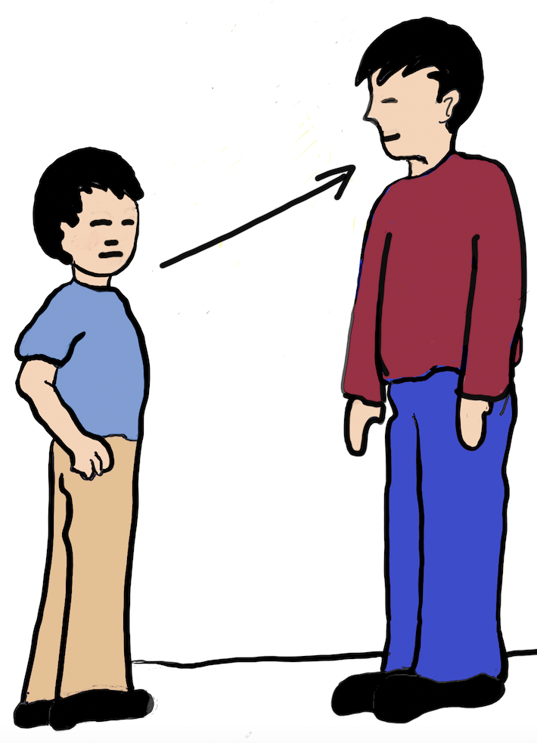
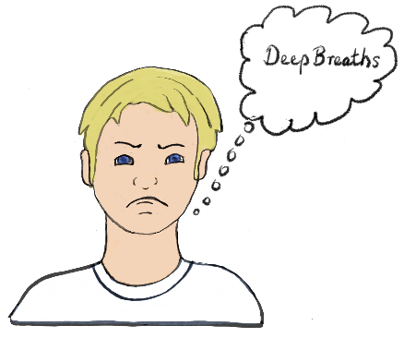
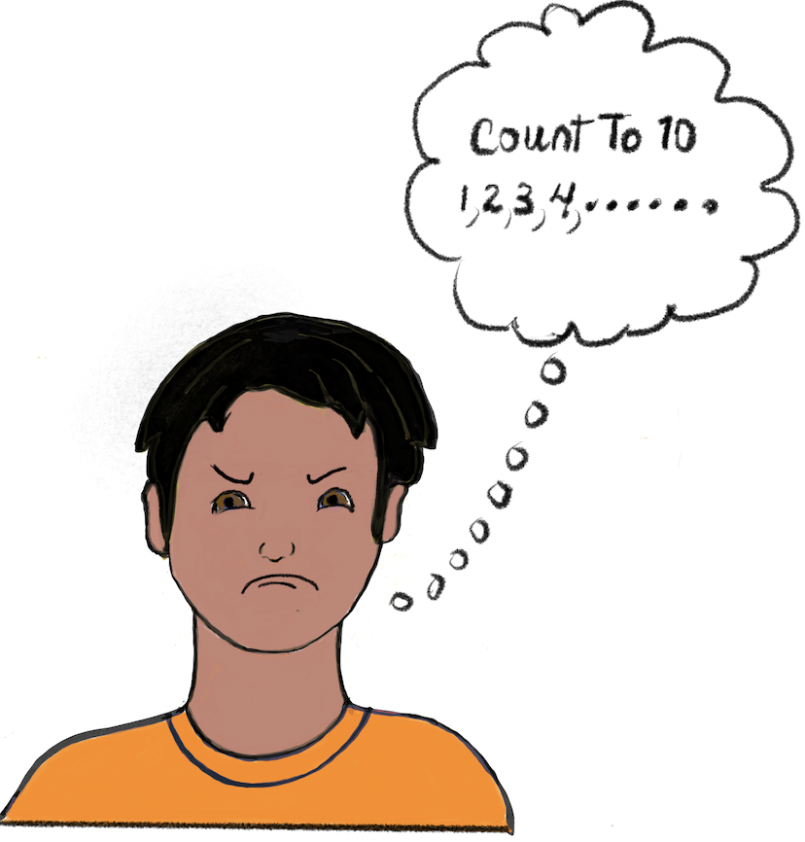
What Do You Do When You’re Frustrated?
Notes:
Slide Discussion
What do you think you should do if someone or something is making you feel frustrated?
(Allow/Guide students to respond and discuss as needed.)
>Cry
>Throw something.
>Fight.
>Give up.
>Deep breaths.
>Count to ten.
>Tell someone.

Slide 7
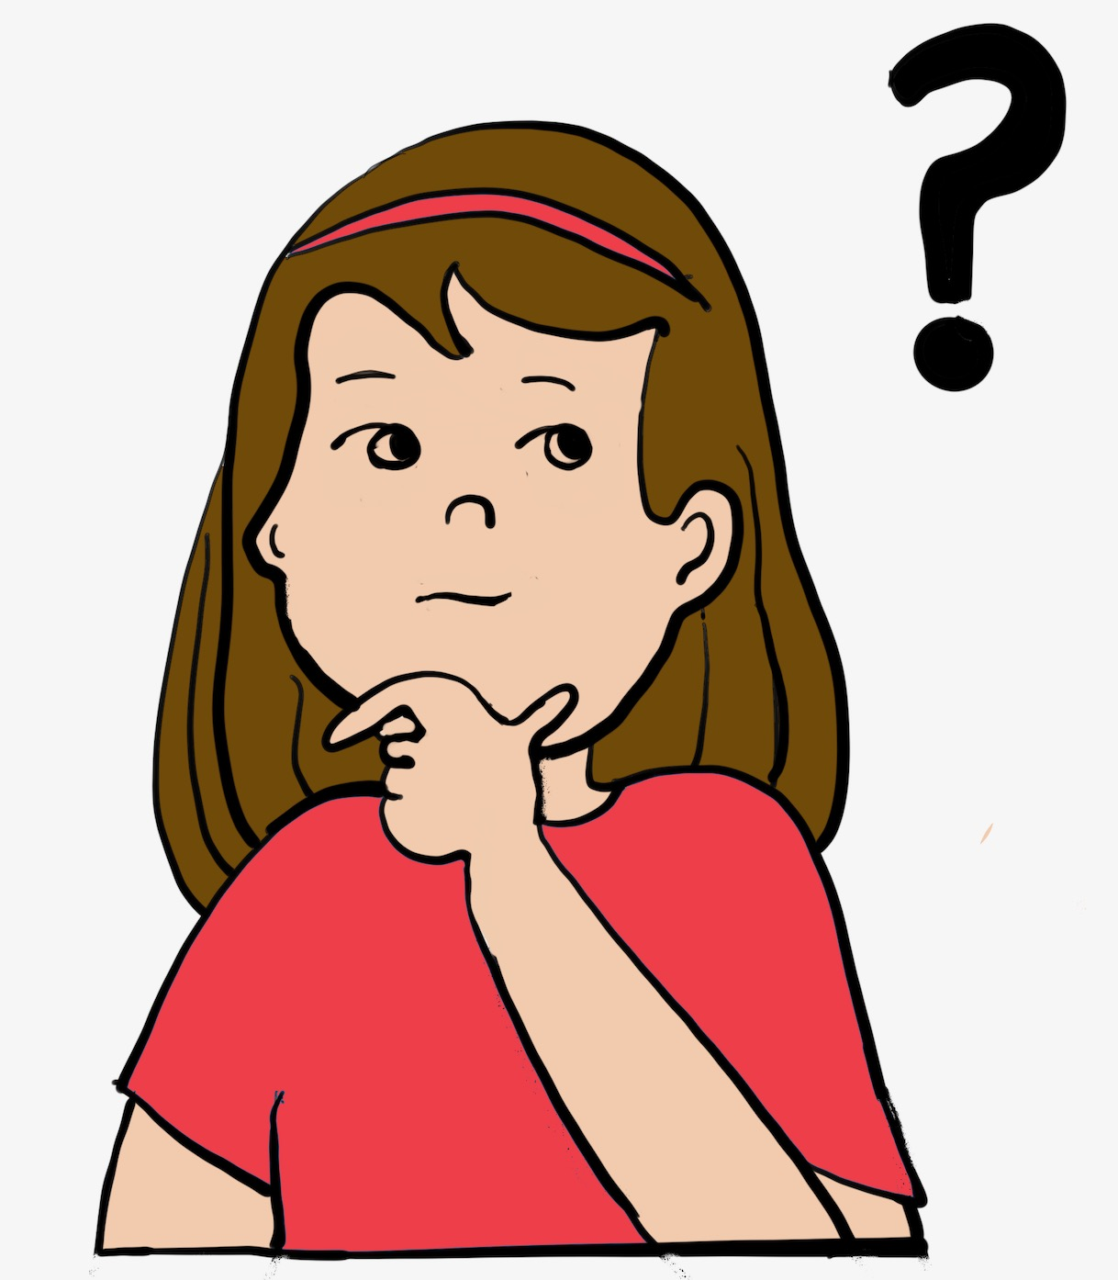
What Can You Do When Someone Else Is Frustrated?
Notes:
Slide Discussion
What do you think you should do if someone else is feeling frustrated?
(Allow/Guide students to respond.)
>Ask them if they are ok, if you feel safe.
>Help them talk to a safe person about their feelings.
>Tell a safe person about the person who is frustrated.

Slide 8
Communicating Frustrated
Notes:
Slide Discussion
If you are frustrated, do you think you should be quiet or tell someone? (Allow/Guide students to respond.)
>Tell someone.
If someone or something makes you feel frustrated, don’t hold it in. It is important to get help from a safe person and make a plan to change the situation. Holding in frustrated feelings is not good for you and does not help things get better.

Slide 9
Notes:
Copyright 2006 by Safe Life Coalition
All rights reserved.
Pre-Video Discussion
Let’s watch someone talk about a feeling.
Play Video
(Video clip plays.)
Post-Video Discussion
What do you know about this person’s feelings now? (Allow/Guide students to respond.)

Slide 10
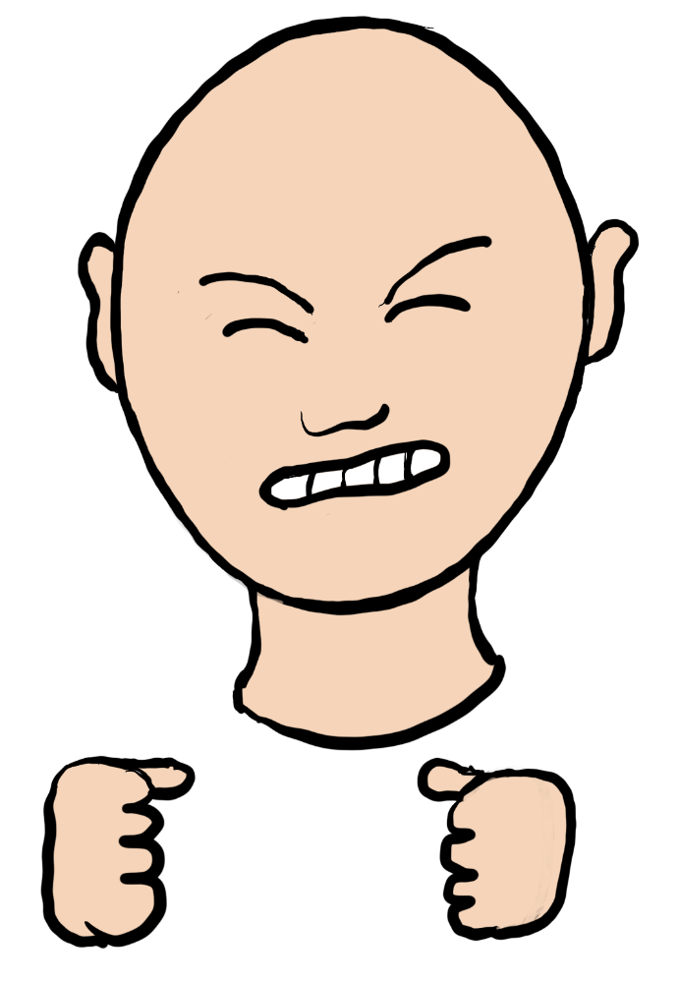
Communicating Frustrated Feelings
Notes:
Slide Discussion
Let’s practice communicating information about feelings.
I want you to take turns practicing telling me (or another student) about something that made you feel frustrated.
(Allow/Coach students to take turns communicating a feeling using sentence structures below as a guide.)
>I felt frustrated when (what happened).
>I feel frustrated because (why).
>I feel frustrated when (what causes the feeling).
Teacher Tip
This is an excellent skill for students to practice as they continue grow and develop healthy friendships, as well as problem solving/reporting skills.

Slide 11
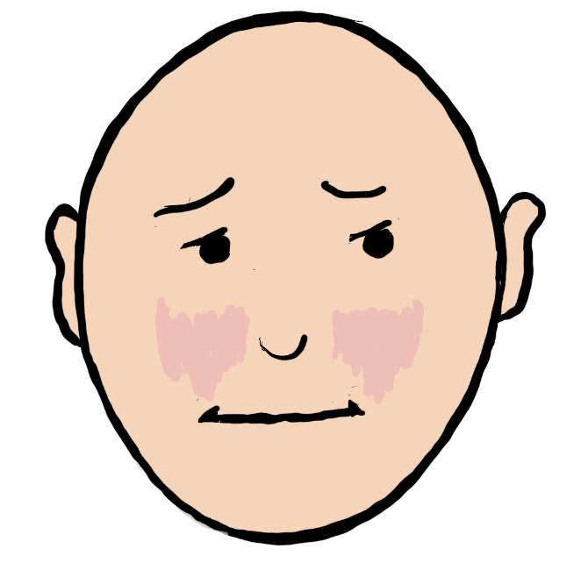
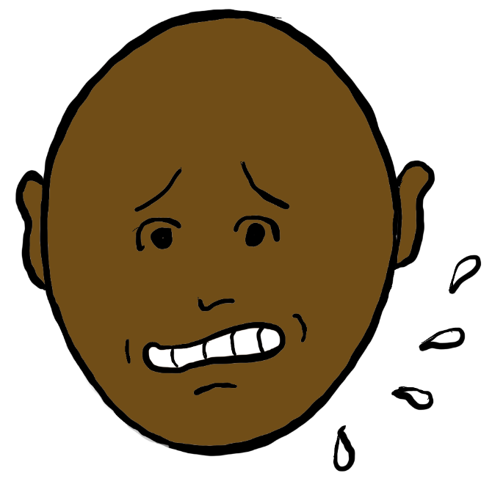
MORE FEELINGS!
Notes:
Slide Discussion
You all are so good at this!
I am going to show you a few more feelings. I usually save these for older classes, but this class is ready for them now!

Slide 12
Notes:
Copyright 2006 by Safe Life Coalition
All rights reserved.
Pre-Video Discussion
Here’s a music video clip. Let’s watch and listen to the words.
Play Video
(Video clip plays.)
Post-Video Discussion
What did you all think of that song? (Allow/Guide students to respond.)

Slide 13
Good Job everyone!
Remember -
Have fun.
Be a thinker.
Stand up for safety!
Peace Out!
Notes:
Copyright 2006 by Safe Life Coalition
All rights reserved.
Play Video
(Video clip plays.)
Post-Video Activity
Anyone want to practice saying what Sammy say’s to end this lesson?
(Call on students and allow/guide them to repeat Sammy lines on this slide.)
Teacher Tip
If you want additional information and materials for lesson concepts covered in this lesson, try using the Safe Life Supplemental Materials & Ideas - Internet Search that is included for this lesson. That document will guide you to locate lesson related YouTube videos, websites, and activity ideas. It also gives you a spot to note any additional materials and ideas you may want to use to teach the lesson.
Lesson Newsletter for Families and Support Persons
Located in lesson folder. Newsletters can be used to share lesson information and reinforcement activities with families/support persons of students. They are printer friendly or can be emailed.

